Slide 1
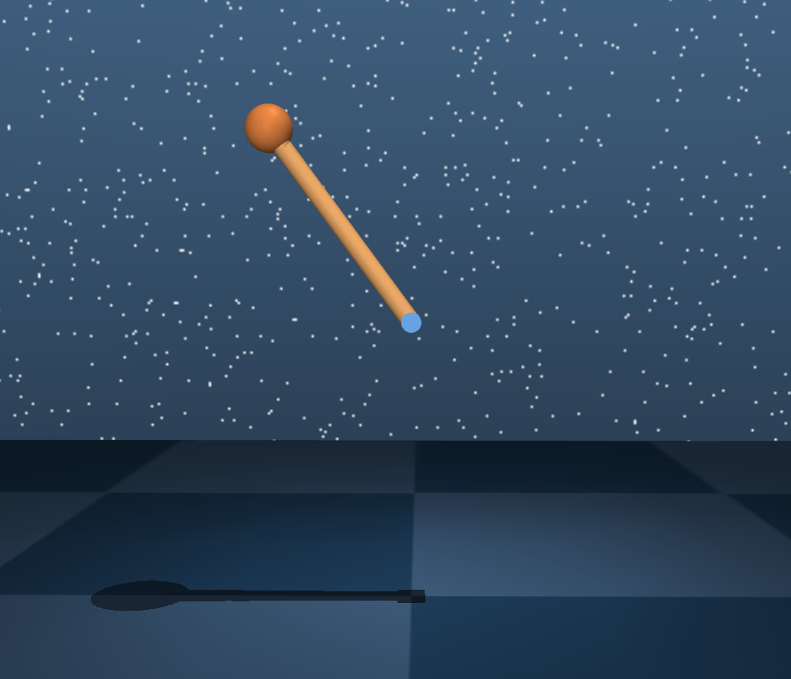
Inverted Pendulum
Ran Wang

Slide 2
Problem statement:
We want the pendulum to swing up to the upright position
2 dimension of states
1 control inputs
2D planar motion
Simulation time 3s
Initial position: rest position
Target position: upright position
Inverted Pendulum
States:
Pendulum: angle, angular velocity
Control inputs: motor at the pin point
3 steps:
Find open loop optimal control using gradient descending
Do system identification along the trajectory and top
Apply discrete LQR controller

Slide 3
Inverted Pendulum
Perturb level = standard deviation/|Umax|*100%
Zero mean Gaussian noise
Averaged by 200 runs
delta_X2 + X2 = f(X1 + delta_X1, U + delta_U)
delta_X2’ + X2 = A*(X1 + delta_X1) + B*(U + delta_U)
Error = (delta_X2’ – delta_X2)/delta_X2
From the figures, the error decreases as timestep decreases. The best perturb level for system identification is between 0.2 and 0.3.

Slide 4
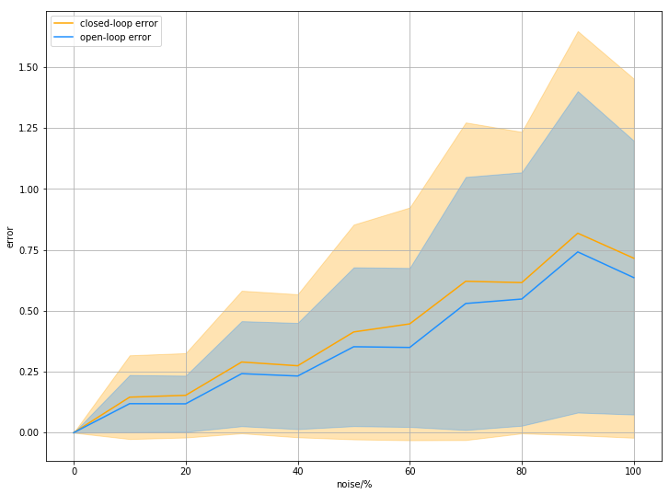
Inverted Pendulum
X2 = f(X1, U), X2’’ = f(X1, U + delta_U)
X2’ = A*(X1) + B*(U + delta_U)
Closed-loop error = (X2’ – X2)/X2
Open-loop error = (X2’’ – X2)/X2
200 runs
Timestep: 0.5s
Sysid noise: 80%
Closed-loop Performance

Slide 5
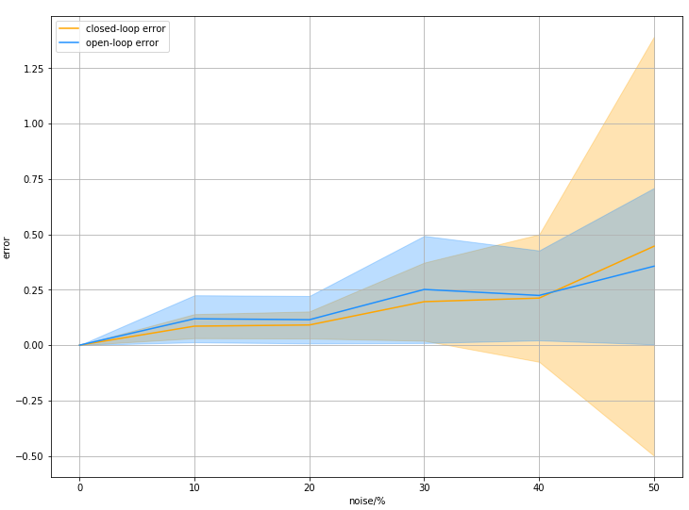
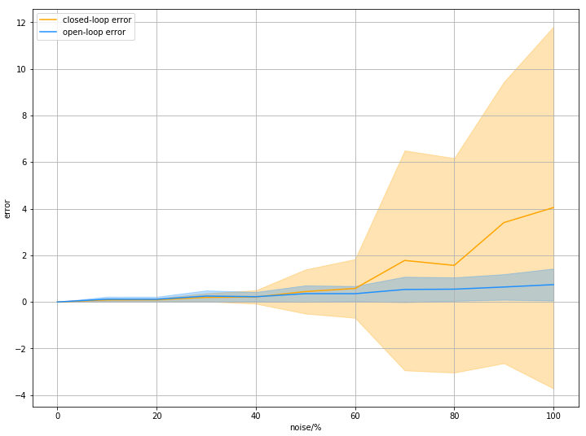
Inverted Pendulum
X2 = f(X1, U), X2’’ = f(X1, U + delta_U)
X2’ = A*(X1) + B*(U + delta_U)
Closed-loop error = (X2’ – X2)/X2
Open-loop error = (X2’’ – X2)/X2
200 runs
Timestep: 0.5s
Sysid noise: 1%
Closed-loop Performance

Slide 6
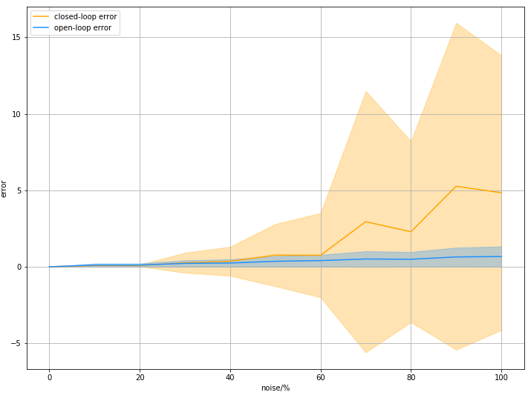
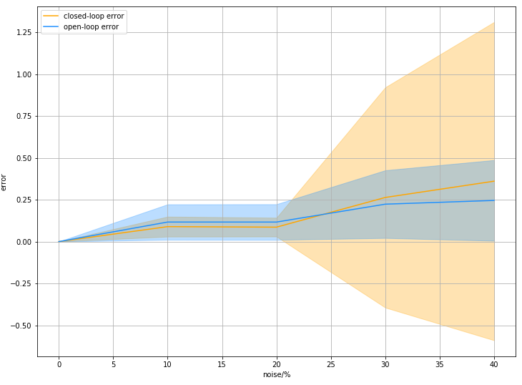
Inverted Pendulum
X2 = f(X1, U), X2’’ = f(X1, U + delta_U)
X2’ = A*(X1) + B*(U + delta_U)
Closed-loop error = (X2’ – X2)/X2
Open-loop error = (X2’’ – X2)/X2
200 runs
Timestep: 0.5s
Sysid noise: 0.01%
Closed-loop Performance

Slide 7
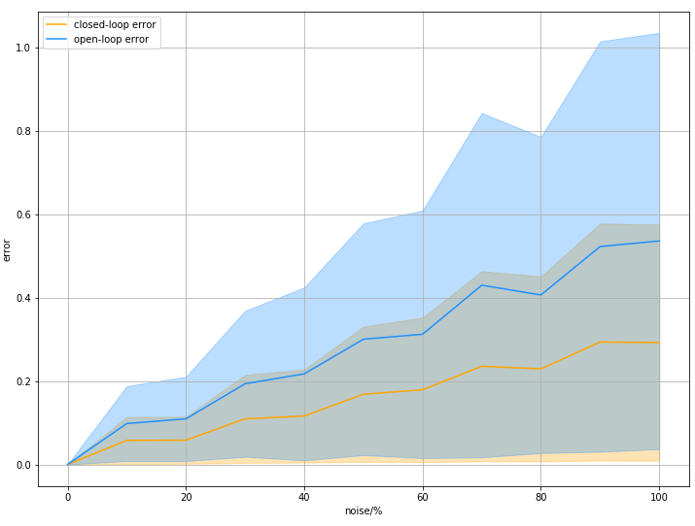
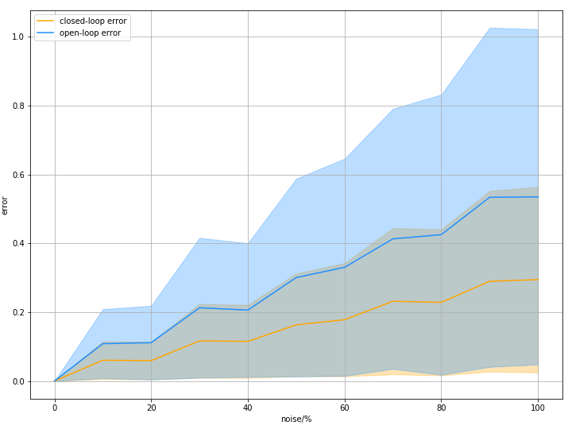
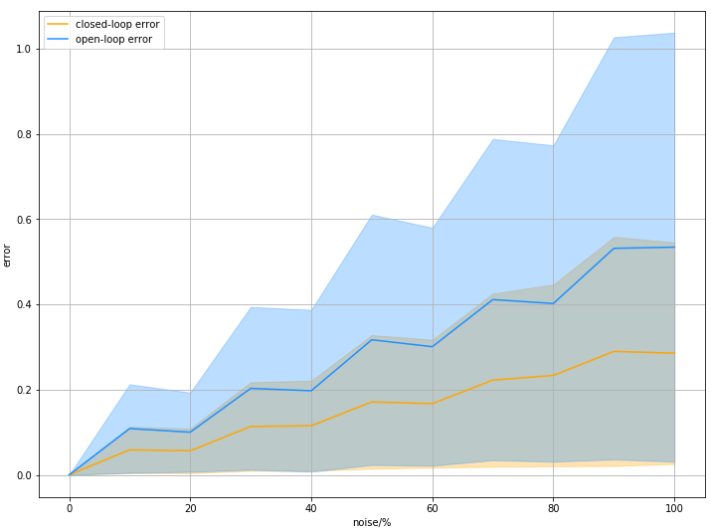
Closed-loop Performance
Inverted Pendulum
Timestep: 0.1s
Sysid noise: 80%
Timestep: 0.1s
Sysid noise: 1%
Timestep: 0.1s
Sysid noise: 0.01%

Slide 8
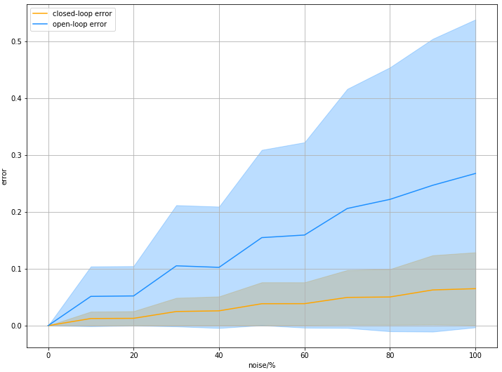
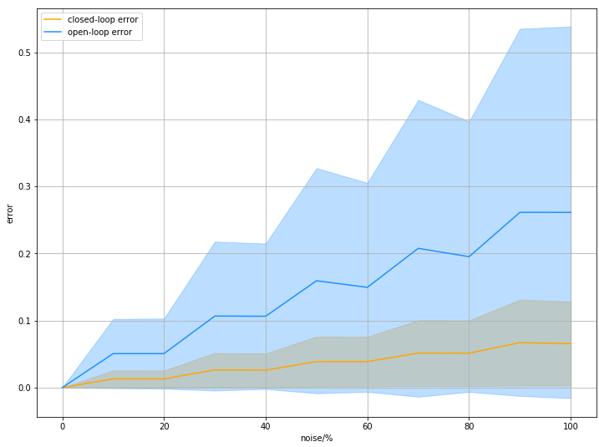
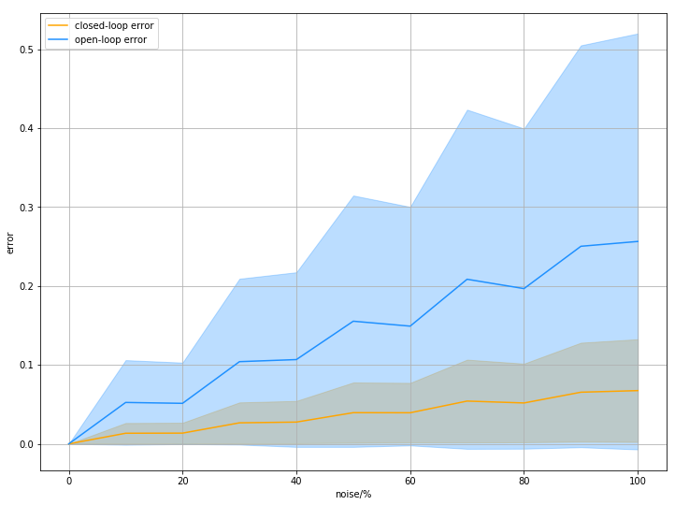
Closed-loop Performance
Inverted Pendulum
Timestep: 0.01s
Sysid noise: 80%
Timestep: 0.01s
Sysid noise: 1%
Timestep: 0.01s
Sysid noise: 0.01%

Slide 9
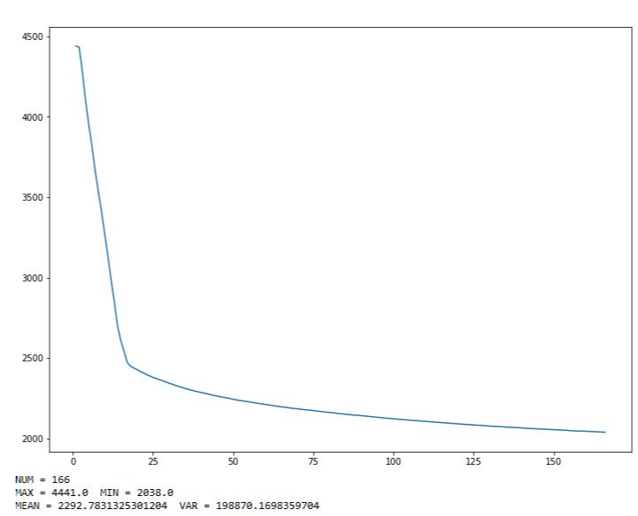
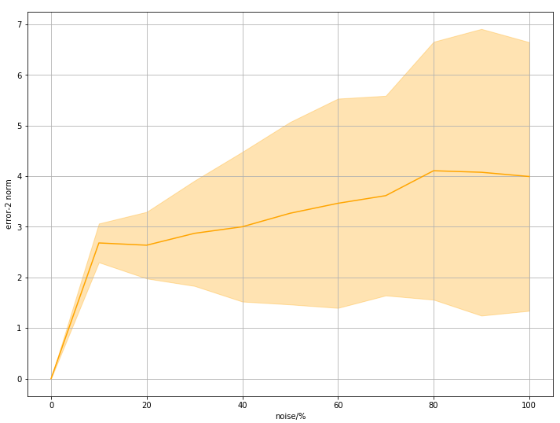
Closedloop error
2-norm
Averaged by 100 samples
Cost curve

Slide 10
Inverted Pendulum
Time/s | 0.01s | 0.1s | 0.5s | 0.1s
Open-loop | 264s | 202s | 187s | 11.23s
Rollout number |  | 800 |  | 180
Iteration | 428 | 533 | 625 | 166
Sysid | 0.71s | 0.48s | 0.47s | 0.07s
Iteration | 1200 | 1200 | 1200 | 170
Control gain K | ~ | ~ | ~ | 0.005s
|Umax| | 3.1 | 3.4 | 3.1 | 13.8

Slide 11
Problem statement:
We want the pendulum to swing up to the upright position
2 dimension of states
1 control inputs
2D planar motion
Simulation time 1s
Initial position: rest position
Target position: upright position
Inverted Pendulum
States:
Pendulum: angle, angular velocity
Control inputs: motor at the pin point
3 steps:
Find open loop optimal control using gradient descending
Do system identification along the trajectory and top
Apply discrete LQR controller

Slide 12
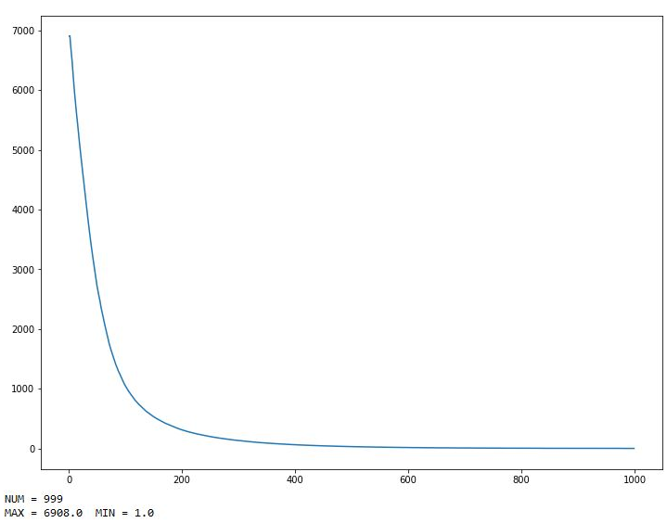
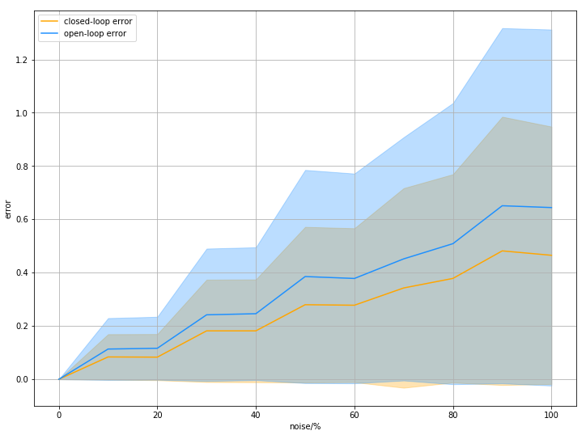
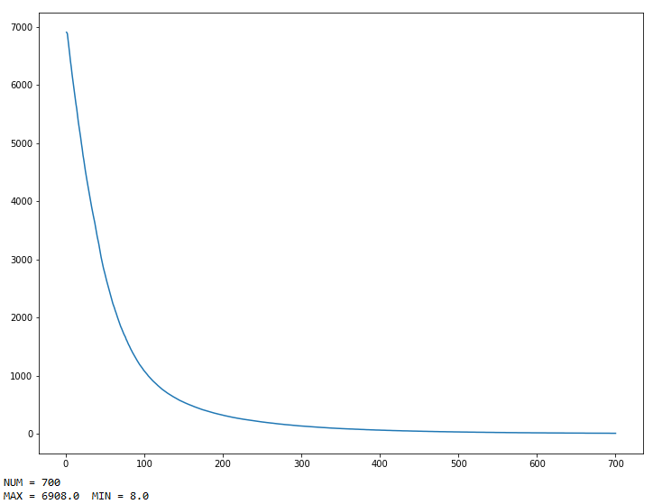
Inverted Pendulum
Time/s | 0.1s | 0.1s
Open-loop | 26.54s | 18.81s
Total step | 10 | 10
Rollout number | 200 | 200
Iteration | 999 | 700
Sysid | 0.06s | -
Iteration | 400 | -
Control gain K | 0.03s | -
|Umax| | 7.1 | 6.9
Final error | (0.04,0.008) | (0.1,0.024)
Cost | 700*I | 700*I

Slide 13
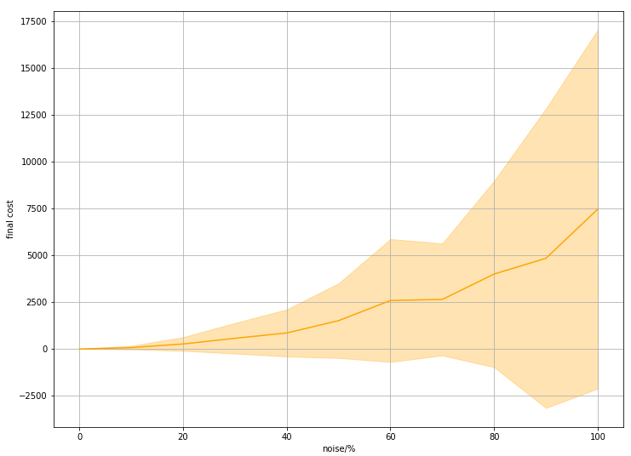

Slide 14
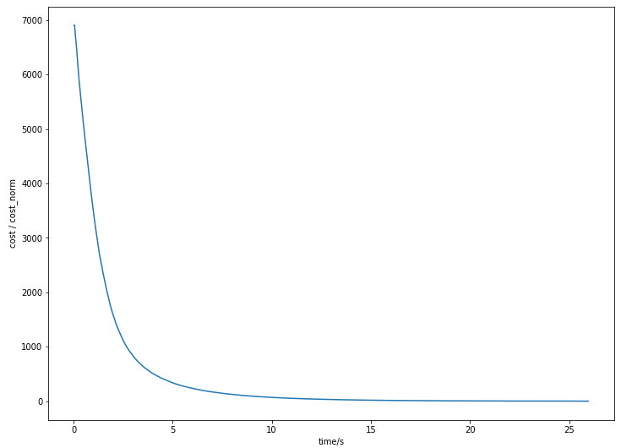
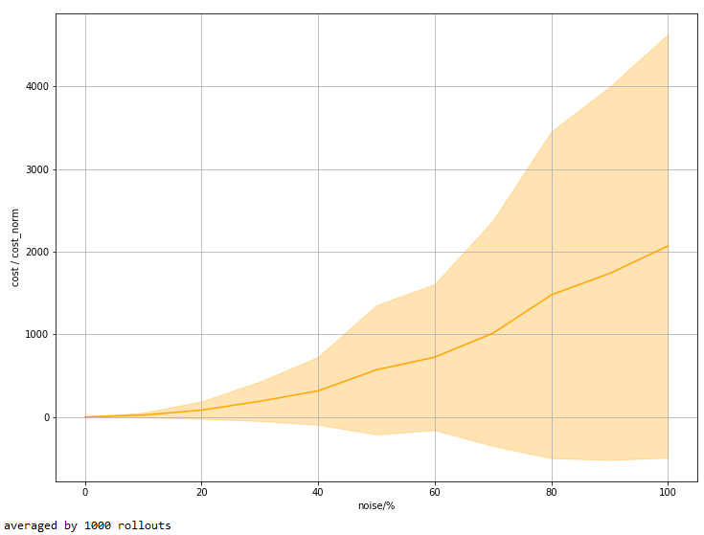
Noise level = std of noise/root mean square of control sequence
Same time horizon
Same control frequency
Different cost parameters

Slide 15
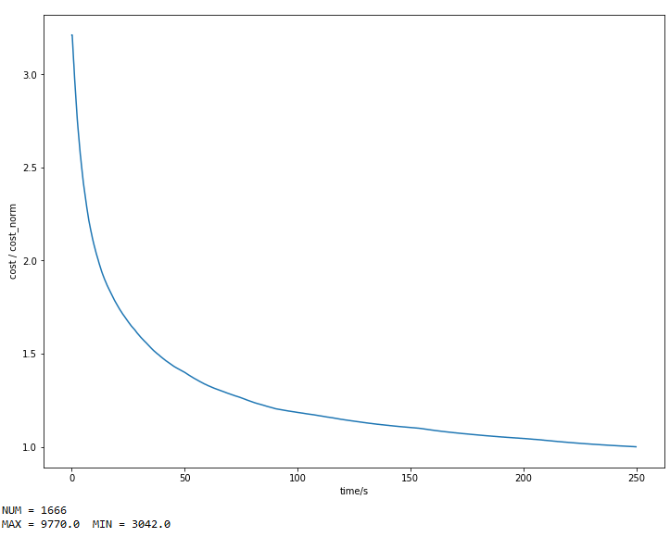
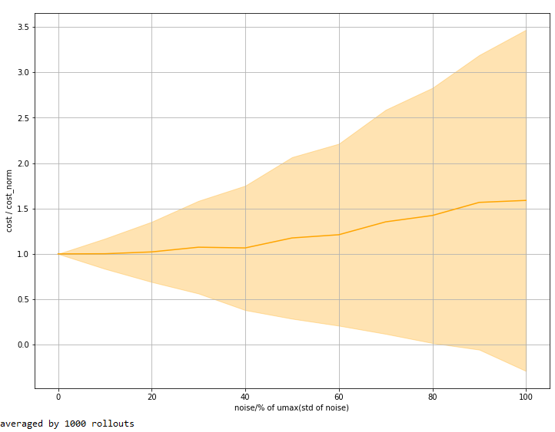
Time/s | 0.1s
Open-loop | 242s
Total step | 30
Rollout number | 200
Iteration | 1666
Sysid | 0.16s
Iteration | 400
Control gain K | 0.03s
|Umax| | 5.3
Cost | 10*I，700*I

Slide 16
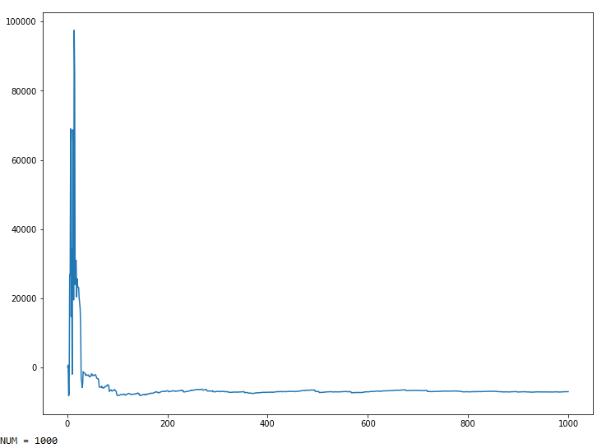
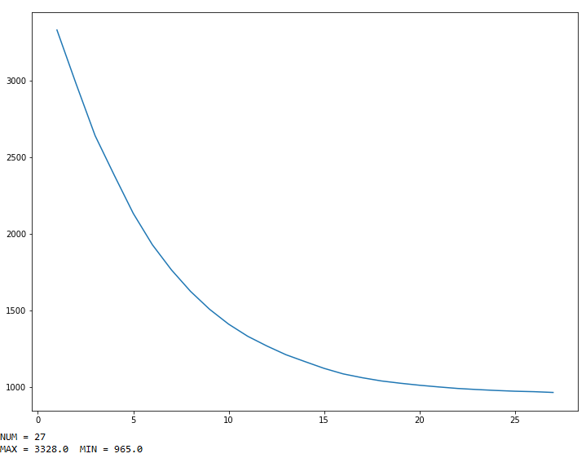
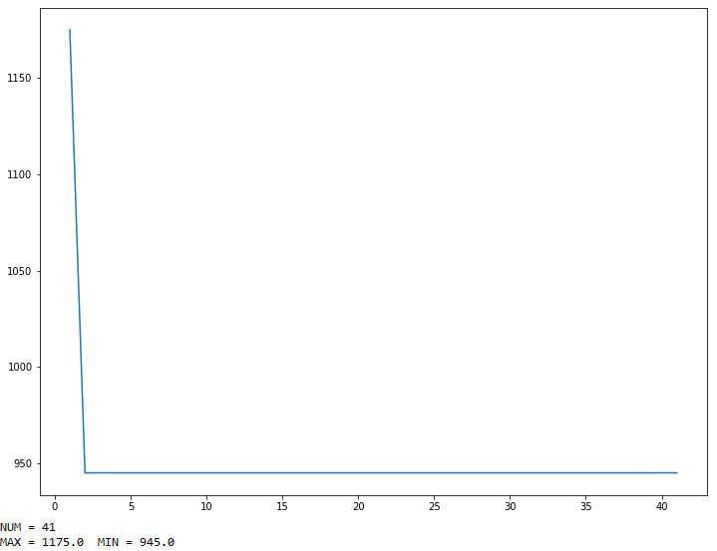
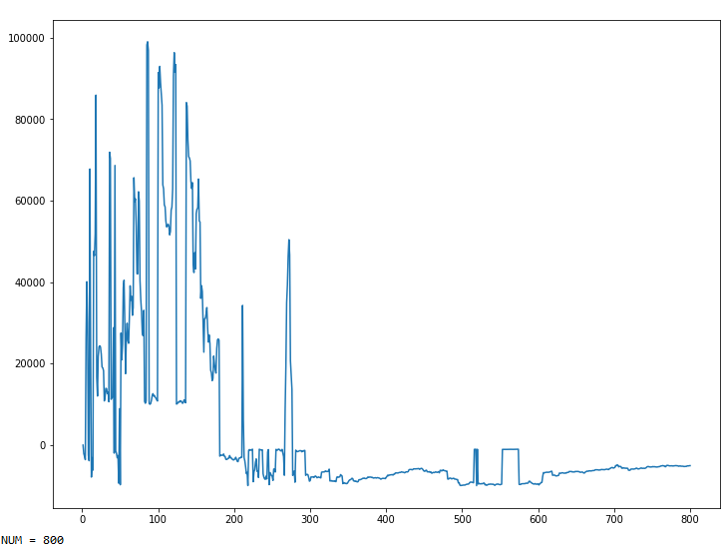
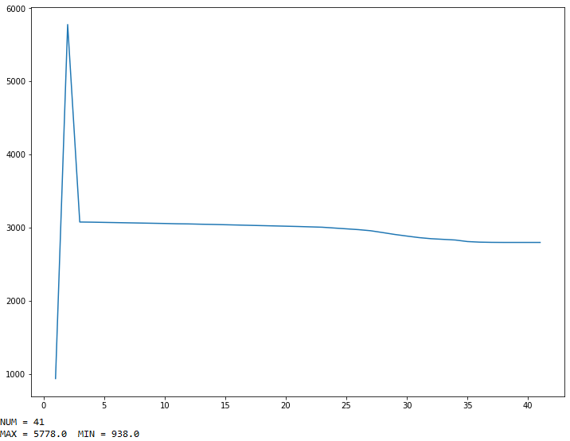
ptb_coef: 0.0001
step_coef: 0.000000005
Umax=5
ptb_coef: 0.0001
step_coef: 0.000000005
10,700
ptb_coef: 0.0003
step_coef: 0.000000000005

Slide 17
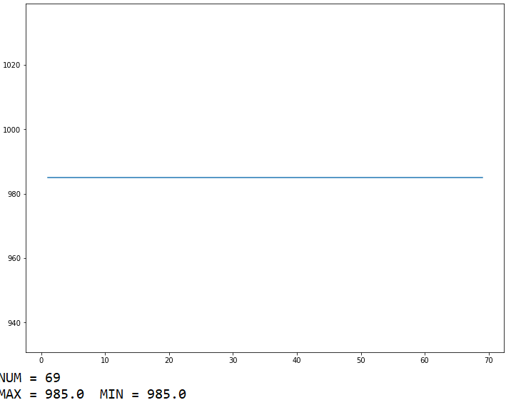
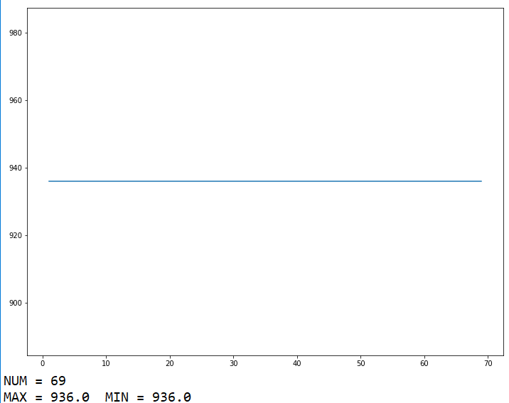
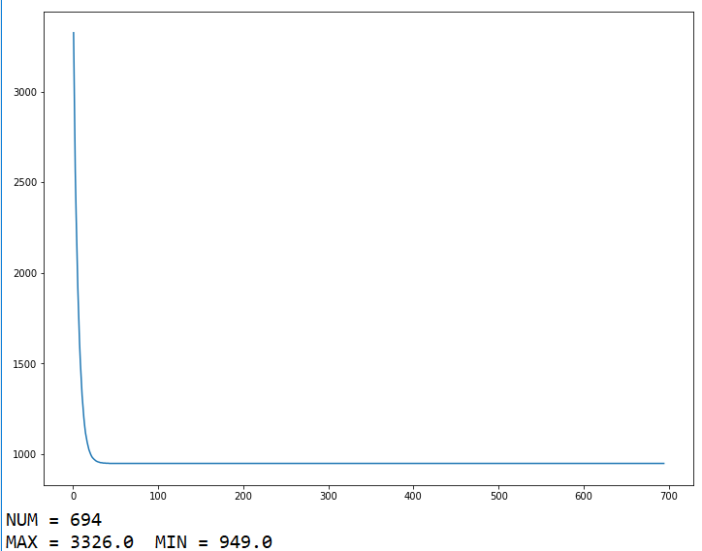
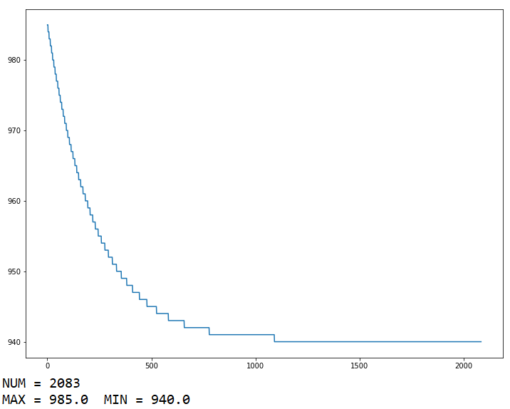
Exact DDPG solution as initial guess
With terminal cost=700, incremental cost=10
Exact DDPG solution as initial guess
With terminal cost=incremental cost=10
ptb_coef: 0.0000001
step_coef: 0.00000000001
Changed DDPG solution as initial guess
With terminal cost=700, incremental cost=10
Changed DDPG solution as initial guess
With terminal cost=10, incremental cost=10

Slide 18
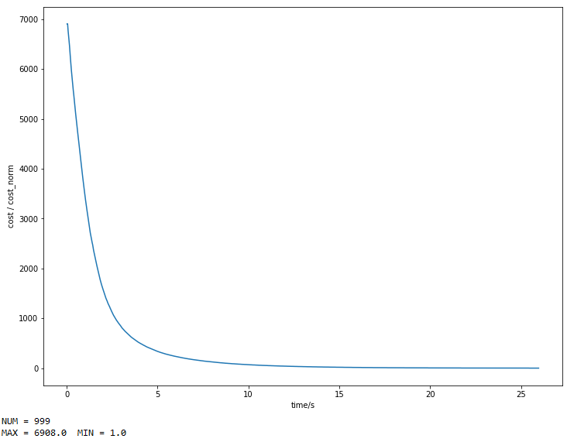
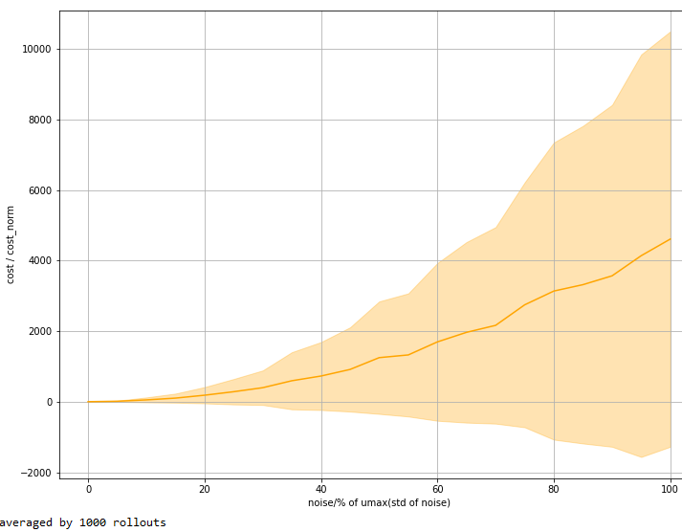
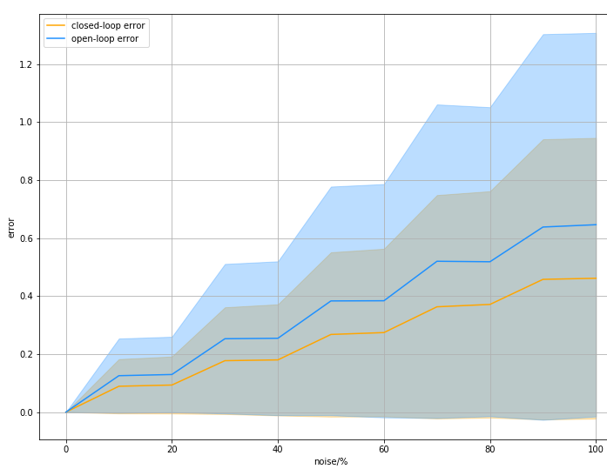
Time/s | 0.1s
Open-loop | 26.54s
Total step | 10
Rollout number | 200
Iteration | 999
Sysid | 0.06s
Iteration | 400
Control gain K | 0.03s
|Umax| | 7.1
Final error | (0.04,0.008)
Cost | 700*I

Slide 19
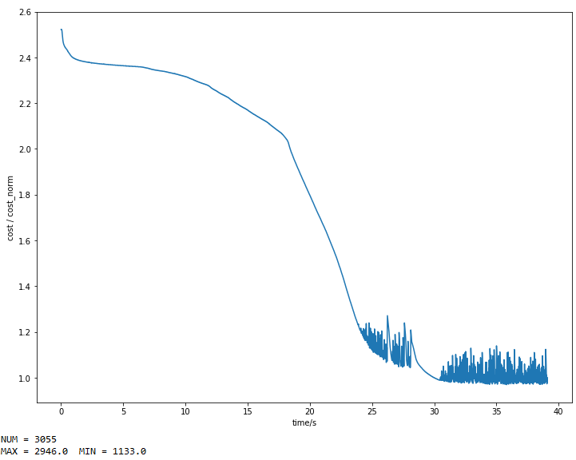
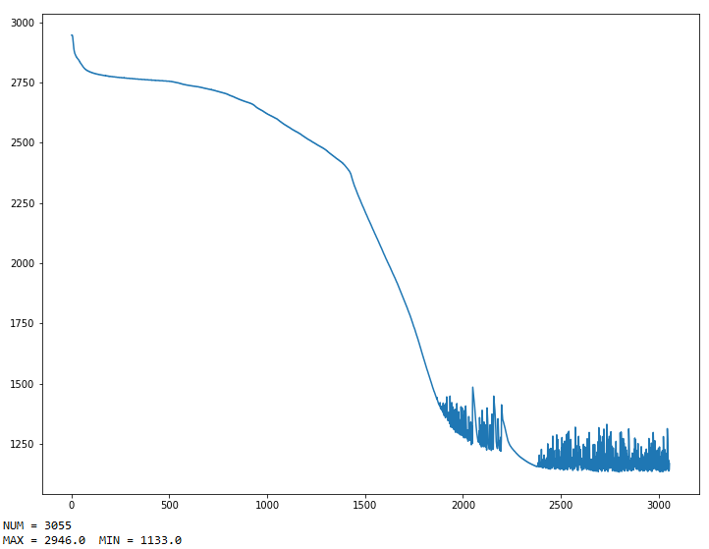
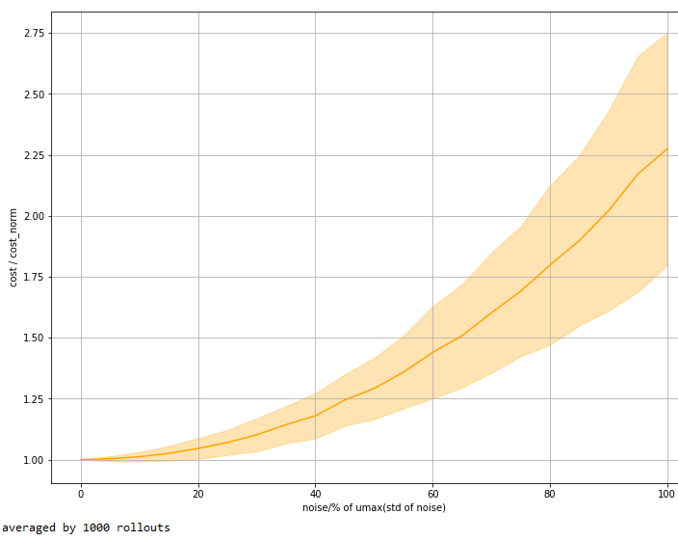
Time/s | 0.1s
Open-loop | 39.4s
Total step | 30
Rollout number | 240
Iteration | 3055
Sysid | 0.06s
Iteration | 400
Control gain K | 0.03s
|Umax| | 5.2
Cost | 10*I

Slide 20
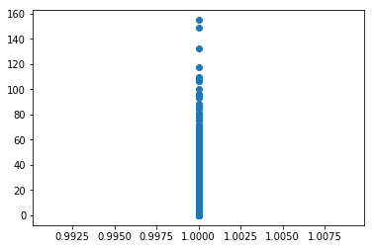
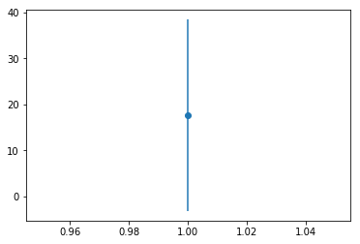
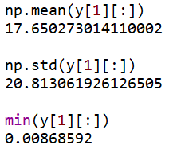

Slide 21
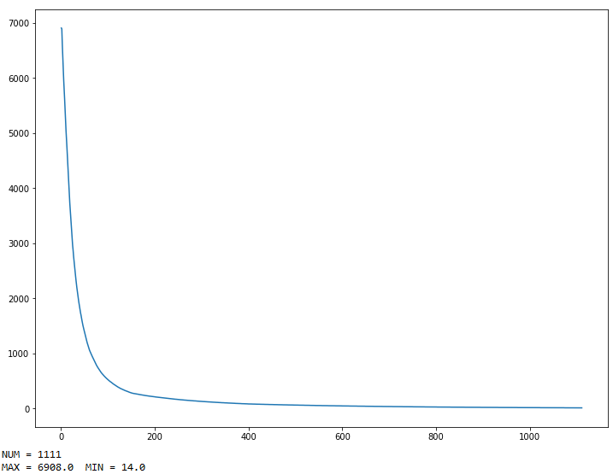
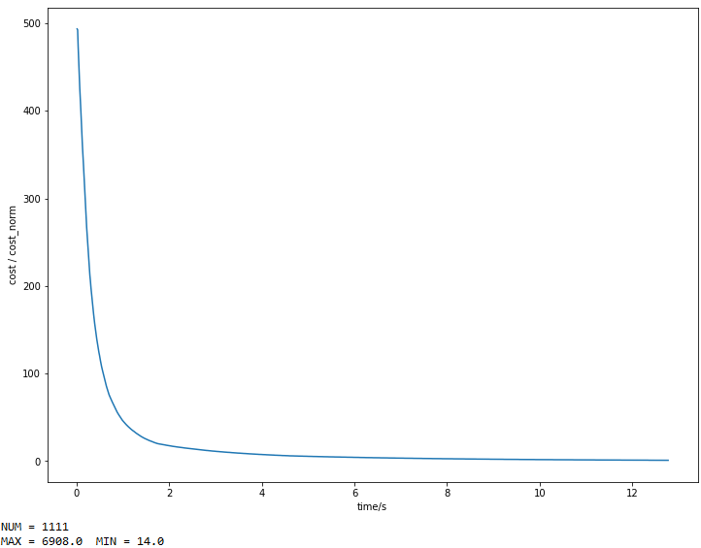
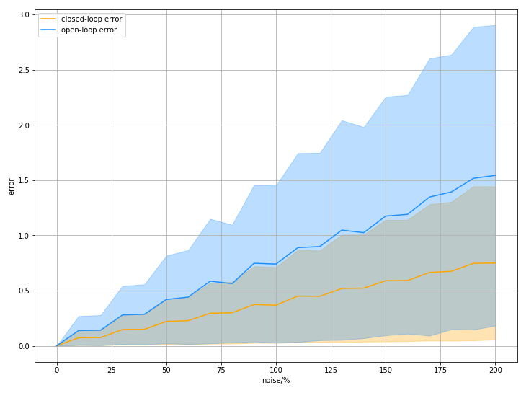
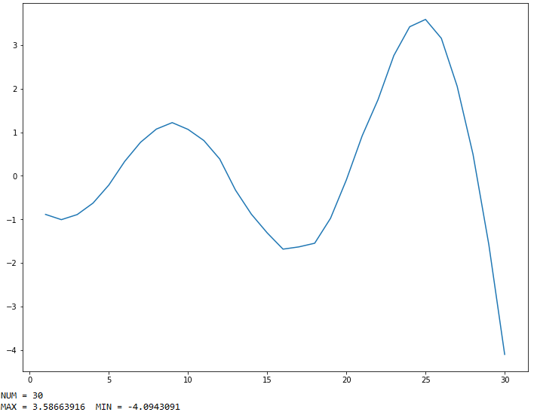
Time/s | 0.1s
Open-loop | 12.9s
Total step | 30
Rollout number | 240
Iteration | 1111
Sysid(0.5%) | 0.03s
Iteration | 500
Control gain K | ~
|Umax| | 4.1
Cost | 700*I，r=0.00001

Slide 22
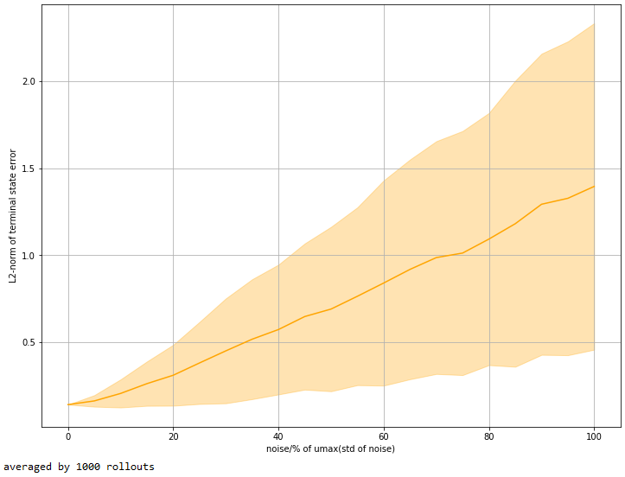
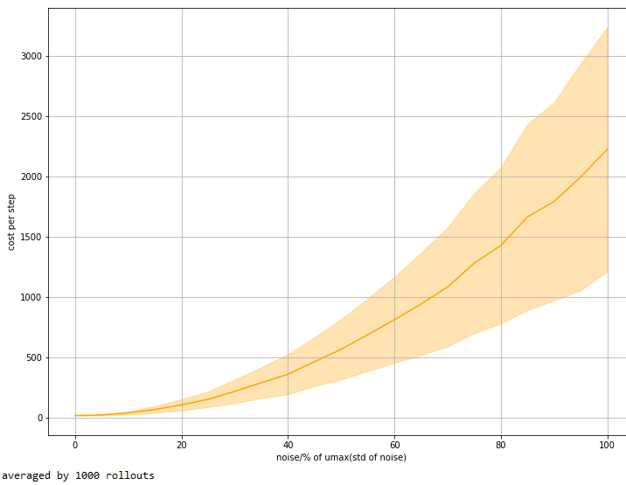
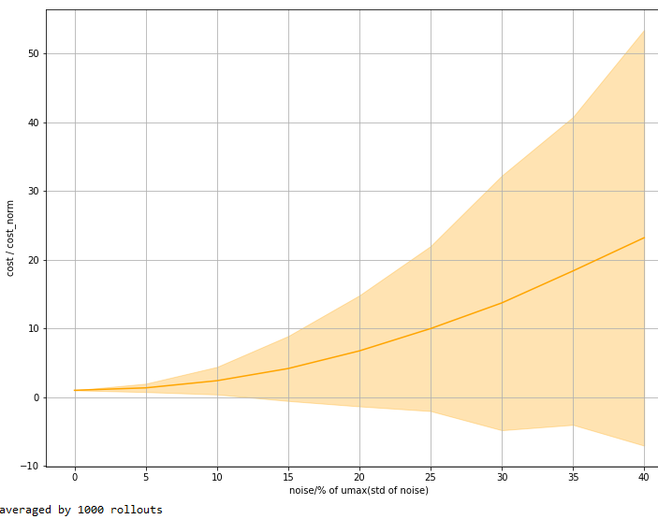
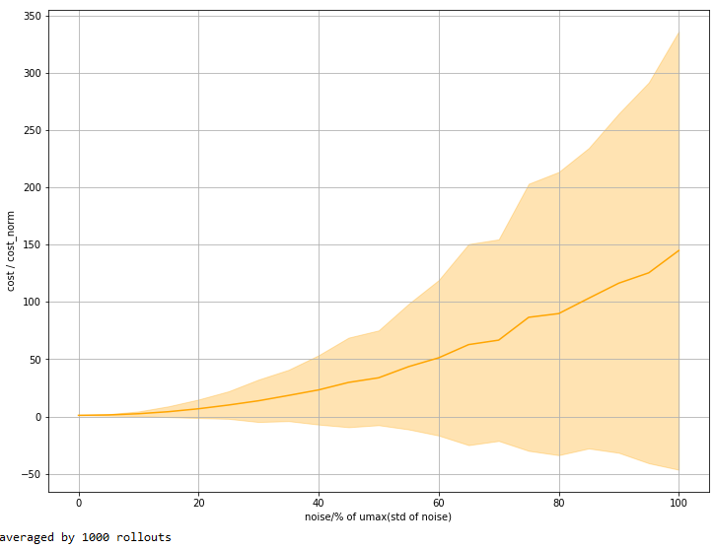

Slide 23
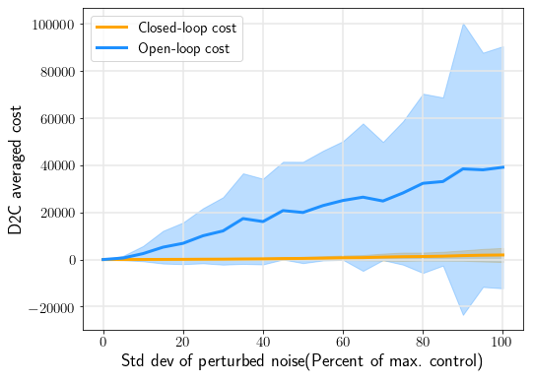

Slide 24
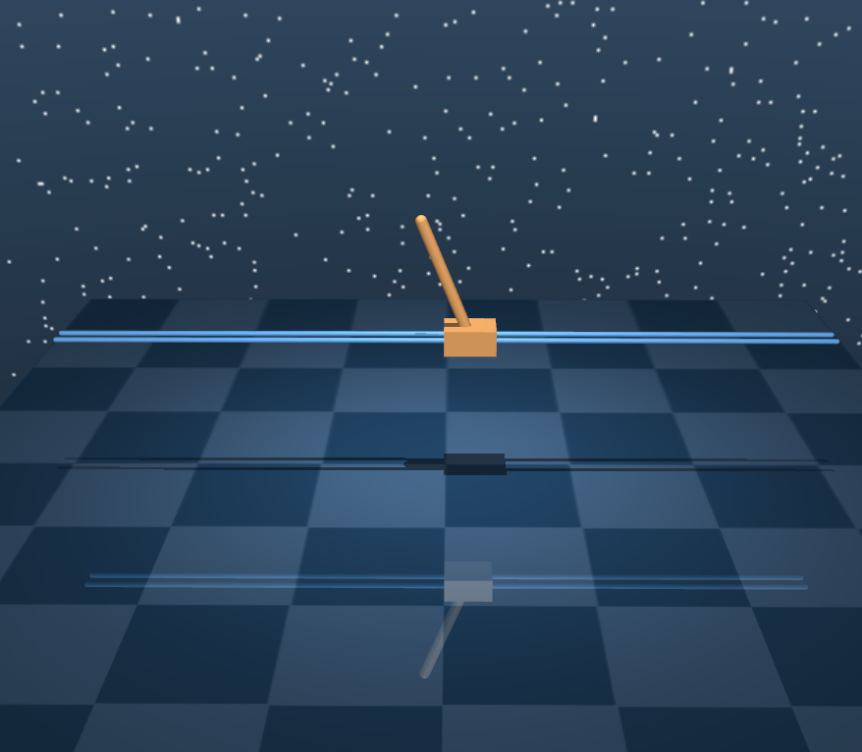
Cartpole
Ran Wang

Slide 25
Problem statement:
We want the pole to swing up to the upright position
4 dimension of states
1 control inputs
2D planar motion
Simulation time 3333333s
Initial position: rest position
Target position: upright position
Cartpole
States:
Cart: position, velocity
Pole: angle, angular velocity
Control inputs: motor for the cart
3 steps:
Find open loop optimal control using gradient descending
Do system identification along the trajectory and top
Apply discrete LQR controller

Slide 26
Cartpole
Perturb level = standard deviation/|Umax|*100%
Zero mean Gaussian noise
Averaged by 200 runs
delta_X2 + X2 = f(X1 + delta_X1, U + delta_U)
delta_X2’ + X2 = A*(X1 + delta_X1) + B*(U + delta_U)
Error = (delta_X2’ – delta_X2)/delta_X2

Slide 27


Cartpole
X2 = f(X1, U), X2’’ = f(X1, U + delta_U)
X2’ = A*(X1) + B*(U + delta_U)
Closed-loop error = (X2’ – X2)/X2
Open-loop error = (X2’’ – X2)/X2
200 runs
Closed-loop Performance
Timestep: 0.5s
Sysid noise: 60%
Timestep: 0.5s
Sysid noise: 1%

Slide 28


Cartpole
X2 = f(X1, U), X2’’ = f(X1, U + delta_U)
X2’ = A*(X1) + B*(U + delta_U)
Closed-loop error = (X2’ – X2)/X2
Open-loop error = (X2’’ – X2)/X2
200 runs
Closed-loop Performance
Timestep: 0.5s
Sysid noise: 0.3%
Timestep: 0.5s
Sysid noise: 0.01%

Slide 29





Cartpole
Closed-loop Performance
Timestep: 0.1s
Sysid noise: 60%
Timestep: 0.1s
Sysid noise: 10%
Timestep: 0.1s
Sysid noise: 1%
Timestep: 0.1s
Sysid noise: 0.3%
Timestep: 0.1s
Sysid noise: 0.01%

Slide 30





Closed-loop Performance
Cartpole
Timestep: 0.01s
Sysid noise: 60%
Timestep: 0.01s
Sysid noise: 10%
Timestep: 0.01s
Sysid noise: 1%
Timestep: 0.01s
Sysid noise: 0.3%
Timestep: 0.01s
Sysid noise: 0.01%

Slide 31
Cartpole
Time/s | 0.01s | 0.1s | 0.5s | 0.1s
Open-loop | 2889s | 2935s | 1755s | 264.7s
Iteration | 1111 | 1388 | 666 | 462
Rollout number |  | 1500 |  | 360
Sysid | 3.06s | 2.82s | 2.74s | 0.5s
Iteration | 1200 | 1200 | 1200 | 300
Control gain K | ~ | ~ | ~ | 0.002s
|Umax| | 7.76 | 7.3 | 10.2 | 6.64

Slide 32
Problem statement:
We want the pole to swing up to the upright position
4 dimension of states
1 control inputs
2D planar motion
Simulation time 25s
Initial position: rest position
Target position: upright position
Cartpole
States:
Cart: position, velocity
Pole: angle, angular velocity
Control inputs: motor for the cart
3 steps:
Find open loop optimal control using gradient descending
Do system identification along the trajectory and top
Apply discrete LQR controller

Slide 33



Cartpole
Time/s | 0.1s | 0.05s
Total step | 25 | 50
Open-loop | 783.22s | 1314s
Rollout number | 200 | 300
Iteration | 2999 | 3333
Sysid | 0.58s | 0.8s
Iteration | 400 | 500
Control gain K | 0.026s | -
|Umax| | 13 | 13.6
Final error | (0.13,0.18,0.2,0.26) | (0.05,0.14,0.26,0.22)
Cost | 120 120 600 120 | 480 240 720 240

Slide 34



Slide 35


Time/s | 0.1s
Total step | 30
Open-loop | 543s
Rollout number | 200
Iteration | 1666
Sysid | 1.1s
Iteration | 600
Control gain K | 0.03s
|Umax| | 15
Cost | 480 240 720 240

Slide 36

20 10 30 10

Slide 37




Time/s | 0.1s
Total step | 30
Open-loop | 15s
Rollout number | 240
Iteration | 347
Sysid | 1.3s
Iteration | 600
Control gain K | 0.03s
|Umax| | 8.2
Cost | 200 100 500 100

Slide 38



Slide 39

3-link SWIMMER
Ran Wang

Slide 40

3-link swimmer
Problem statement:
We want the swimmer to reach the target
10 states
2 control inputs
2D planar motion
Time step 0.006s
Simulation time 12s
2000 steps
45 degree turning
Initial position: (0, 0)
Target position: (0.6, 0.6)
3 steps:
Find open loop optimal control using gradient descending
Do system identification along the trajectory
Design discrete LQR controller along the trajectory

Slide 41
3-link swimmer
States:
Head: x position, y position, x velocity, y velocity, angle, angle velocity
1st link: angle, angle velocity relative to the head
2nd link: angle, angle velocity relative to the first link
Control inputs: motor between head and 1st link
+ motor between 1st link and 2nd link
Umax = 5.632
Umean = 0.014 Uvar = 2.428

Slide 42

3-link swimmer
Noise level = standard deviation/|Umax|*100%
Zero mean Gaussian noise
Averaged by 100 runs
delta_X2 + X2 = f(X1 + delta_X1, U + delta_U)
delta_X2’ + X2 = A*(X1 + delta_X1) + B*(U + delta_U)
Error = (delta_X2’ – delta_X2)/delta_X2
From the figures, the error decreases as timestep decreases. The best noise level for system identification is between 0.2 and 0.3. Pick timestep 0.006s and noise level 0.3 for the system identification and continue with the closed-loop step.

Slide 43

X2 = f(X1, U), X2’’ = f(X1, U + delta_U)
X2’ = A*(X1) + B*(U + delta_U)
Closed-loop error = (X2’ – X2)/X2
Open-loop error = (X2’’ – X2)/X2
3-link swimmer
Timestep: 0.006s
Sysid noise: 0.3%
200 runs
Closed-loop Performance
Both open-loop and closed-loop errors increases as noise increases.
When noise level is below 40%, the closed-loop error mean and deviation is smaller than the open-loop.
The closed-loop is performing better.
If keep increasing the noise, the closed-loop error will increase abruptly.

Slide 44



Time/s | 0.01s
Total step | 800
Open-loop | 4001s
Rollout number | 300
Iteration | 4166
Sysid | 4.1s
Iteration | 800
Control gain K | 0.5s
|Umax| | 17.6
Cost | (16 8) (200 100) r=0.0001

Slide 45




Slide 46


Time/s | 0.01s
Total step | 800
Open-loop | 4001s
Rollout number | 300
Iteration | 4166
Sysid | 4.1s
Iteration | 800
Control gain K | 0.5s
|Umax| | 14.9
Cost | (16 8) (200 100) r=0.0001

Slide 47


Slide 48



Time/s | 0.005s
Total step | 1600
Open-loop | 7861s
Rollout number | 800
Iteration | 1562
Sysid | 12.6s
Iteration | 1200
Control gain K | 0.5s
|Umax| | 16.1
Cost | (2.5 2.5) (2000 6000 2000 6000) r=0.001

Slide 49



Slide 50

6-link SWIMMER
Ran Wang

Slide 51

6-link swimmer
Problem statement:
We want the swimmer to reach the target
16 states
5 control inputs
2D planar motion
Time step 0.006s
Simulation time 12s
2000 steps
45 degree turning
Initial position: (0, 0)
Target position: (0.6, 0.6)
3 steps:
Find open loop optimal control using gradient descending
Do system identification along the trajectory
Design discrete LQR controller along the trajectory

Slide 52
6-link swimmer
States:
Head: x position, y position, x velocity, y velocity, angle, angle velocity
1st link: angle, angle velocity relative to the head
2nd link: angle, angle velocity relative to the 1st link
3rd link: angle, angle velocity relative to the 2nd link
4th link: angle, angle velocity relative to the 3rd link
5th link: angle, angle velocity relative to the 4th link
Control inputs: motors between the 6 links
Umax = -4.510
Umean = 0.050 Uvar = 1.281

Slide 53
6-link swimmer
Noise level = standard deviation/|Umax|*100%
Zero mean Gaussian noise
Averaged by 100 runs
delta_X2 + X2 = f(X1 + delta_X1, U + delta_U)
delta_X2’ + X2 = A*(X1 + delta_X1) + B*(U + delta_U)
Error = (delta_X2’ – delta_X2)/delta_X2
From the result of the 3-link swimmer, error decreases as timestep decreases. Here pick timestep 0.006 for the 6-link swimmer.
The figure shows the sysid has the lowest error around noise level 0.3%. Pick noise level 0.3 for the system identification and continue with the closed-loop step.

Slide 54

X2 = f(X1, U), X2’’ = f(X1, U + delta_U)
X2’ = A*(X1) + B*(U + delta_U)
Closed-loop error = (X2’ – X2)/X2
Open-loop error = (X2’’ – X2)/X2
6-link swimmer
Timestep: 0.006s
Sysid noise: 0.3%
100 runs
Closed-loop Performance
Both open-loop and closed-loop errors have an upward trend as the noise increases.
The closed-loop error mean and deviation is always smaller than the open-loop.
The closed-loop is performing better than the open-loop.

Slide 55
Summary
For 3-link and 6-link swimmers, timestep 0.006s and sysid noise level 0.3% are a good set of parameters.
The closed-loop steadily works better than the open-loop under some noise level.
Time consuming:
Time/s | 3-link | 6-link
Open-loop | 19200 | 27400
Sys id | 900 | 1200
Control gain K | 120 | 210

Slide 56



Time/s | 0.006s
Total step | 1500
Open-loop | 9489.3s
Rollout number | 600
Iteration | 1481
Sysid | 26s
Iteration | 1400
Control gain K | 0.5s
|Umax| | 7.9
Cost | (2 2) (200 200 1000 1000) r=0.001

Slide 57




Slide 58


Time/s | 0.01s
Total step | 900
Open-loop | 3585.4s
Rollout number | 600
Iteration | 925
Sysid | 15.9s
Iteration | 1400
Control gain K | 0.5s
|Umax| | 8.9
Cost

Slide 59


Slide 60

FISH
Ran Wang

Slide 61
Fish
Problem statement:
We want the fish to reach the target
27 dimensions of states
5 control inputs
3D planar motion
Time step 0.005s
Simulation time 8s
1600 steps
45 degree turning
Initial position: (0, 0, 0)-upside down
Target position: (0, 0.4, 0.2)-upright
3 steps:
Find open loop optimal control using gradient descending
Do system identification along the trajectory
Design discrete LQR controller along the trajectory
d->qpos[3][4][5][6] are quaternions

Slide 62



Time/s | 0.005s
Total step | 1600
Open-loop | 10826s
Rollout number | 600
Iteration | 972
Sysid | 106.5
Iteration | 1300
Control gain K | 0.52
|Umax| | 13.6
Cost

Slide 63


Slide 64



Time/s | 0.0005s
Total step | 16000
Open-loop | 149054s
Rollout number | 500
Iteration | 2495
Sysid | 1059.8
Iteration | 1300
Control gain K | 1.1
|Umax| | 18.2
Cost

Slide 65



Slide 66


Time/s | 0.005s
Total step | 1600
Open-loop | 2307.5s
Rollout number | 600
Iteration | 312
Sysid | 118.5
Iteration | 1600
Control gain K | 0.6
|Umax| | 6.5
Cost

Slide 67


Time/s | 0.002s
Total step | 4000
Open-loop | 14705.2s
Rollout number | 600
Iteration | 312
Sysid | 68.3
Iteration | 1600
Control gain K | 0.6
|Umax| | 12.8
Cost

Slide 68
Fish
Problem statement:
We want the fish to reach the target
27 dimensions of states
6 control inputs
3D planar motion
45 degree turning
Initial position: (0, 0, 0)-upright
Target position: (0, 0.4, 0.2)-upright
3 steps:
Find open loop optimal control using gradient descending
Do system identification along the trajectory
Design discrete LQR controller along the trajectory
d->qpos[3][4][5][6] are quaternions

Slide 69

Time/s | 0.002s
Total step | 2500
Open-loop | 24000s
Rollout number | 800
Iteration | -
Sysid | 103.3
Iteration | 1600
Control gain K | 0.7
|Umax| | 7.5
Cost

Slide 70


X2 = f(X1, U), X2’’ = f(X1, U + delta_U)
X2’ = A*(X1) + B*(U + delta_U)
Closed-loop error = (X2’ – X2)/X2
Open-loop error = (X2’’ – X2)/X2

Slide 71

0.02 to 0.002
Time/s | 0.02s both | 0.02s ctrl/0.002s sim
Total step | 300 | 300
Open-loop | 1800s | 4h
Rollout number | 600 | 600
Iteration | -
Sysid | 103.3
Iteration | 1600
Control gain K | 0.7
|Umax|
Cost

Slide 72



Time/s | 0.002s
Total step | 3000
Open-loop | 12940.3s
Rollout number | 600
Iteration | 971
Sysid | 272.1
Iteration | 1600
Control gain K | 0.7
|Umax| | 6.9
Cost

Slide 73



Time/s | 0.005s（3600000）
Total step | 1200
Open-loop | 6011.2s
Rollout number | 400
Iteration | 1498
Sysid | 75.1
Iteration | 1000
Control gain K | 0.5
|Umax| | 2.7
Cost

Slide 74



Slide 75


Time/s | 0.004s
Total step | 2000
Open-loop | 1031.0s
Rollout number | 30
Iteration | 2000
Sysi(0.0001 4 threads)） | 7.37
Iteration | 40
Control gain K | 0.5
|Umax| | 10.6
Cost

Slide 76


Slide 77



No quaternion feedback
3456
No 6
No 345

Slide 78


Umax=3
Full feedback

Slide 79



Openloop
Closedloop
6% noise
Nominal

Slide 80

CHEETAH
Ran Wang

Slide 81

Cheetah
Problem statement:
We want the fish to reach the target
18 dimensions of states
6 control inputs
2D planar motion
Time step 0.005s
Simulation time 5s
1000 steps
Initial position: (0, 0, 0)
Target: x velocity d->qvel[0]=3
3 steps:
Find open loop optimal control using gradient descending
Do system identification along the trajectory
Design discrete LQR controller along the trajectory

Slide 82


Time/s | 0.005s
Total step | 1000
Open-loop | 3082.3
Rollout number | 800
Iteration | 350
Sysid
Iteration
Control gain K
|Umax| | 5.8
Cost

Slide 83


Time/s | 0.05s
Total step | 100
Open-loop | 555.2
Rollout number | 500
Iteration | 840
Sysid
Iteration
Control gain K
|Umax| | 0.5
Cost

Slide 84


Time/s | 0.05s/0.1s
Total step | 50
Open-loop | 362.1
Rollout number | 300
Iteration | 933
Sysid
Iteration
Control gain K
|Umax| | 0.5
Cost

Slide 85


pendulum
cartpole

Slide 86




swimmer6
swimmer3
fish

Slide 87

HOPPER
Ran Wang

Slide 88
Hopper
Problem statement:
We want the fish to reach the target
14 dimensions of states
4 control inputs
2D planar motion
Control Time step 0.01s
Simulation Time step 0.01s
Simulation time 5s
500 steps
Initial states: { 0.0 }
Target: hop forward
3 steps:
Find open loop optimal control using gradient descending
Do system identification along the trajectory
Design discrete LQR controller along the trajectory

Slide 89

Time/s | 0.01s
Total step | 500
Open-loop
Rollout number | 700
Iteration
Sysid
Iteration
Control gain K
|Umax| | 14.0
Cost

Slide 90

HUMANOID
Ran Wang

Slide 91
Humanoid
Problem statement:
We want the fish to reach the target
55 dimensions of states
21 control inputs
3D planar motion
Control Time step 0.02s
Simulation Time step 0.005s
Simulation time 5s
250 steps
Initial states: { 0.0, 0.0, 0, 0, 1.3, 0, 1, 0, 0 }
Target: run forward
3 steps:
Find open loop optimal control using gradient descending
Do system identification along the trajectory
Design discrete LQR controller along the trajectory

Slide 92


Time/s | 0.02s/0.005s
Total step | 250
Open-loop | 45762.39
Rollout number | 500
Iteration | 1171
Sysid
Iteration
Control gain K
|Umax| | 8.2
Cost

Slide 93


Slide 94

Dbar Reacher
Ran Wang

Slide 95
Dbar Reacher
Problem statement:
We want the top to reach the target
52 dimensions of states from auto modeling
Should be reduced to 8 (4 are free)
4 control inputs
2D planar motion
Initial states: { 0 }
Target: reach target
3 steps:
Find open loop optimal control using gradient descending
Do system identification along the trajectory
Design discrete LQR controller along the trajectory

Slide 96


Dbar Reacher
Time/s | 0.1s/0.02s
Total step | 40
Open-loop | 3132.7
Rollout number | 300
Iteration | 400
Sysid
Iteration
Control gain K
|Umax| | 8.2
Cost

Slide 97


Dbar Reacher
Time/s | 0.1s/0.02s
Total step | 40
Open-loop | 154.7
Rollout number | 300
Iteration | 400
Sysid
Iteration
Control gain K
|Umax| | 8.1
Cost

Slide 98


Dbar Reacher
Time/s | 0.05s
Total step | 40
Open-loop | 41.08
Rollout number | 300
Iteration | 600
Sysid | 0.31
Iteration | 300
Control gain K | 0.24
|Umax| | 5.2
Cost

Slide 99


Dbar Reacher

Slide 100


Dbar Reacher
Time/s | 0.1s
Total step | 10
Open-loop | 13.23
Rollout number | 300
Iteration | 600
Sysid | 0.09
Iteration | 1000
Control gain K | ~
|Umax| | 5.8
Cost

Slide 101


Dbar Reacher

Slide 102


Dbar Reacher
Time/s | 0.02s damping=2,viscousity=0.5
Total step | 50
Open-loop | 60.3
Rollout number | 300
Iteration | 600
Sysid | 0.4
Iteration | 1000
Control gain K | ~
|Umax| | 6.9
Cost

Slide 103


Dbar Reacher

Slide 104


Dbar Reacher
Time/s | 0.02s damping,viscousity=0.1
Total step | 50
Open-loop | 57.03
Rollout number | 300
Iteration | 600
Sysid | 0.4
Iteration | 1000
Control gain K | ~
|Umax| | 6.5
Cost

Slide 105


Dbar Reacher

Slide 106
Dbar Reacher
Time/s | 0.02s damping,viscousity=0.1
Total step | 50
Open-loop | 57.03
Rollout number | 300
Iteration | 600
Sysid | 0.02
rollout | 16
Control gain K | ~
|Umax| | 6.5
Cost

Slide 107


Dbar Reacher

Slide 108


Dbar Reacher
Time/s | 0.02s damping,viscousity=0.1
Total step | 50
Open-loop | 2.11s
Rollout number | 10
Iteration | 600
Sysid | 0.02
rollout | 16
Control gain K | ~
|Umax| | 8.4
Cost
Tension greater than 0

Slide 109

Finger
Ran Wang

Slide 110
Finger
Problem statement:
We want the finger tip to reach the target
10 dimensions of states
10 control inputs
2D planar motion
Initial states: { 0 }
Target: reach target
3 steps:
Find open loop optimal control using gradient descending
Do system identification along the trajectory
Design discrete LQR controller along the trajectory

Slide 111


Finger
Time/s | 0.02s damping,viscousity=0.1
Total step | 100
Open-loop | 167.28
Rollout number | 300
Iteration | 600
Sysid | 1.53
Iteration | 1000
Control gain K | ~
|Umax| | 6.5
Cost

Slide 112

Finger

Slide 113


Finger
Time/s | 0.02s damping=0.5,viscousity=0.1
Total step | 200
Open-loop | 99.15s
Rollout number | 300
Iteration | 200
Sysid | 0.5s/0.15s with 4 threads
rollout | 40
Control gain K | 0.13s
|Umax| | 6.8
Cost
Smallest sysid err is about 0.02 while the smallest err from previous method is 0.3

Slide 114


Finger
0.02s damping=0.5, viscousity=0.1

Slide 115


Finger
NEW METHOD:+-delta
Time/s | 0.02s damping=0.5,viscousity=0.1
Total step | 200
Open-loop | 136.5s
Rollout number | 300
Iteration | 200
Sysid
rollout
Control gain K
|Umax| | 6.8
Cost

Slide 116


pendulum
Time/s | 0.1s OLD | +- | Latest seq
Open-loop | 12.9s | 24.7s | 13.1
Total step | 30
Rollout number | 240 | 480 | 240
Iteration | 1111
Sysid(0.5%) | 0.03s
Iteration | 500
Control gain K | ~
|Umax| | 4.1
Cost | 700*I，r=0.00001

Slide 117

Arm
Ran Wang

Slide 118
Arm
Problem statement:
We want the tip to reach the target
40 dimensions of states (without constraint)
38 control inputs
2D planar motion
Initial states: { 0 }
Target: reach target
3 steps:
Find open loop optimal control using gradient descending
Do system identification along the trajectory
Design discrete LQR controller along the trajectory

Slide 119



Arm
Modeling with different constraints
1. No constraint, the model collapsed.
2. Every vertical bar is fixed with the previous horizontal bar,20 states
Both 2 and 3 work well, and used in the closed loop shown in the previous slides.
3. Starts from the 2nd vertical bar, 2 vertical bars and the bar in between are fixed together forming a H shape unit.

Slide 120


Arm
Time/s | 0.02s
Open-loop | 116.1s
Total step | 300
Rollout number | 20
Iteration | 600
Sysid(0.1%) | 10.3/3.62s 4 threads
Iteration | 60
Control gain K | 0.6
|Umax| | 8.8
Cost
2. Every vertical bar is fixed with the previous horizontal bar,20 states

Slide 121


Arm
0.02s damping=0.5, viscousity=0.1

Slide 122


Arm
Time/s | 0.02s
Open-loop | 54.9s
Total step | 200
Rollout number | 20
Iteration | 500
Sysid(0.1%) | 1.89s 4 threads
Iteration | 60
Control gain K | 0.5
|Umax| | 9.3
Cost
4. Every vertical bar is fixed with the next horizontal bar,18 states

Slide 123

Arm
4. Every vertical bar is fixed with the next horizontal bar,18 states

Slide 124


Arm
Time/s | 0.04s
Open-loop | 3691.9s
Total step | 200
Rollout number | 100
Iteration | 6000
Sysid(0.1%)
Iteration
Control gain K
|Umax| | 73.4
Cost
Try to get the swing motion but failed

Slide 125


Slide 126


Arm
Time/s | 0.02s
Open-loop | 79.93s
Total step | 200
Rollout number | 20
Iteration | 600
Sysid(0.1%) | 1.89s 4 threads
Iteration | 60
Control gain K | 0.5
|Umax| | 10
Cost
4. Every vertical bar is fixed with the next horizontal bar,18 states

Slide 127


Arm
Time/s | 0.01s
Open-loop | 149.54s
Total step | 400
Rollout number | 20
Iteration | 600
Sysid(0.1%) | 3.64s 4 threads
Iteration | 60
Control gain K | 0.5
|Umax| | 10.19
Cost
4. Every vertical bar is fixed with the next horizontal bar,18 states

Slide 128

Arm

Slide 129

Swimmer6
Ran Wang

Slide 130
Swimmer6
Problem statement:
We want the head to reach the target
16 dimensions of states (without constraint)
22 control inputs
2D planar motion
Initial states: { 0 }
Target: reach target（0.5，0.5）
3 steps:
Find open loop optimal control using gradient descending
Do system identification along the trajectory
Design discrete LQR controller along the trajectory

Slide 131



Swimmer6t
Terminal cost increased, incremental cost decreased
Time/s | 0.01s
Open-loop | 6831.8s
Total step | 1000
Rollout number | 50
Iteration | 7000
Sysid(0.1%) | 3.34(4 threads)
Iteration | 40
Control gain K | 0.59
|Umax| | 4.8
Cost

Slide 132




Swimmer6t

Slide 133

Swimmer6

Slide 134
Swimmer6
Time/s | 0.01s
Total step | 900
Open-loop | 3585.4s
Rollout number | 600
Iteration | 925
Sysid | 15.9s
Iteration | 1400
Control gain K | 0.5s
|Umax| | 8.9
Cost

Slide 135

Swimmer6t

Slide 136



Swimmer6t
Terminal cost increased, incremental cost decreased
Time/s | 0.01s
Open-loop | 3424.9s
Total step | 1000
Rollout number | 50
Iteration | 3500
Sysid(0.1%) | 4.06(4 threads)
Iteration | 40
Control gain K | 0.6
|Umax| | 2.5
Cost

Slide 137




Swimmer6t

Slide 138
Time/s | 0.006s
Total step | 1500
Open-loop | 9489.3s
Rollout number | 600
Iteration | 1481
Sysid | 26s
Iteration | 1400
Control gain K | 0.5s
|Umax| | 7.9
Cost | (2 2) (200 200 1000 1000) r=0.001
Swimmer6

Slide 139







Time/s | 0.006s
Open-loop | 9446.0s
Total step | 1500
Rollout number | 50
Iteration | 7000
Sysid(0.1%) | 6.25(4 threads)
Iteration | 40
Control gain K | 0.7
|Umax| | 3.3
Cost
Swimmer6t

Slide 140



Swimmer6t

Slide 141


Swimmer6t
Time/s | 0.006s
Open-loop | 9204.0s
Total step | 1500
Rollout number | 50
Iteration | 7000
Sysid(0.1%) | 5.13(4 threads)
Iteration | 40
Control gain K | 0.7
|Umax| | 2.3
Cost

Slide 142



Swimmer6t

Slide 143

Reacher
Ran Wang

Slide 144
Reacher
Problem statement:
We want the head to reach the target
12 dimensions of states
10 control inputs
2D planar motion
Initial states: { 0 }
Target: reach target
3 steps:
Find open loop optimal control using gradient descending
Do system identification along the trajectory
Design discrete LQR controller along the trajectory

Slide 145


Reacher
Time/s | 0.01s
Open-loop | 25.5s
Total step | 300
Rollout number | 20
Iteration | 300
Sysid(0.1%) | 0.36(4 threads)
Iteration | 24
Control gain K | 0.6
|Umax| | 0.9
Cost

Slide 146

Reacher

Slide 147

Reacher
Ran Wang

Slide 148
Reacher
Problem statement:
We want the head to reach the target
28 dimensions of states
22 control inputs
2D planar motion
Initial states: { 0 }
Target: reach target
3 steps:
Find open loop optimal control using gradient descending
Do system identification along the trajectory
Design discrete LQR controller along the trajectory

Slide 149



Reacher
Time/s | 0.01s
Open-loop | 99.4s
Total step | 400
Rollout number | 30
Iteration | 300
Sysid(0.1%) | 3.25(4 threads)
Iteration | 60
Control gain K | 0.5
|Umax| | 0.49
Cost

Slide 150
No damping
+(-0.3,0.3)
Model | T1D1 | T2D1
Time/s | 0.01s | 0.01s
Open-loop | About 300s | About 1500s
Total step | 300 | 400
Rollout number | 200 | 300
Iteration | 600 | 600
Sysid(0.1%)
Iteration
Control gain K
|Umax| | 1.84 | 0.53
Mass | 0.6 | 1

Slide 151
With damping
+(-1,1)
Model | T1D1 | T2D1
Time/s | 0.01s
Open-loop | About 1000s
Total step | 300
Rollout number | 20
Iteration
Sysid(0.1%)
Iteration
Control gain K
|Umax| | 2.3
Mass | 0.4

Slide 152


Reacher
Time/s | 0.01s
Open-loop | 4462.06s
Total step | 400
Rollout number | 300
Iteration | 1300
Sysid(0.1%) | 3.79(4 threads)
Iteration | 60
Control gain K | 0.5
|Umax| | 2.74
Cost

Slide 153



Reacher

Slide 154



Slide 155



Slide 156

3D Dbar
Ran Wang

Slide 157

3D Pendulum
Ran Wang

Slide 158



Full feedback
Only quat feedback
Only vel feedback

Slide 159

Pendulum
q=6 match_q=6
1000 trials
Acc method
5% noise
Pendulum
q=6 match_q=6
1000 trials
True vs ls

Slide 160

swimmer3
q=100 match_q=80
1000 trials
Acc method
True vs qmc
5% noise

Slide 161

swimmer3
q=100 match_q=80
1000 trials
Acc method

Slide 162


Batch=80
Batch=10
pendulum

Slide 163


Batch=40
Start from 41
pendulum

Slide 164


Batch=40 paper example
Batch=80 paper example

Slide 165

Batch=40 paper example start from 41

Slide 166


Add y, batchsize=40
Transform x, batchsize=40

Slide 167


Batch=10
Batch=5

Slide 168


Pendulum Batch=20
Pendulum Batch=5

Slide 169

Pendulum Batch=80

Slide 170

Cartpole Batch=60

Slide 171

Cartpole Batch=60

Slide 172

Swimmer3 no batching timestep=0.001s

Slide 173


Swimmer3
batch=60
check starts at 1
Swimmer3
batch=60
check starts at 31, same abcd

Slide 174


Swimmer3
batch=30
check starts at 1
Swimmer3
batch=30
check starts at 31

Slide 175

Swimmer3
batch=400
check starts at 1
Q=matchq=10
Noise=5%

Slide 176

Pendulum
Matlab lqg noise=10%
Batch=160
Average=1

Slide 177

Pendulum
Matlab lqg
current with D
Batch=160
noise=10%
Averaged over 100

Slide 178

Pendulum
Matlab lqg
current with D
Batch=160
noise=10%
Averaged over 1

Slide 179

Pendulum
Matlab lqg
current D=0
Batch=160
noise=10%
Averaged over 100

Slide 180

Pendulum
Matlab lqg
current D=0
Batch=160
noise=10%
Averaged over 1

Slide 181

Pendulum
cdc2017 lqg
current D=0
Batch=160
noise=10%
Averaged over 1

Slide 182

Pendulum
cdc2017 lqg
current D=0
Batch=160
noise=20%
Averaged over 1

Slide 183

Pendulum
cdc2017 lqg
current D!=0
Batch=160
noise=20%
Averaged over 1

Slide 184

Pendulum
cdc2017 lqg
current D!=0
Batch=160
noise=20%
Averaged over 500

Slide 185

Pendulum
cdc2017 lqg
current D=0
Batch=160
noise=20%
Averaged over 500

Slide 186

Pendulum
cdc2017 lqg
current D=0
Batch=40
noise=20%
Averaged over 500

Slide 187

Pendulum
cdc2017 lqg
current D=0
Batch=40
noise=20%
Averaged over 1

Slide 188

cartpole
cdc2017 lqg
current D!=0
Batch=60
noise=20%
Averaged over 1

Slide 189

cartpole
cdc2017 lqg
current D!=0
Batch=60
noise=20%
Averaged over 1

Slide 190

cartpole
cdc2017 lqg
current D!=0
Batch=60
noise=20%
Averaged over 500

Slide 191

cartpole
cdc2017 lqg
current D!=0
Batch=60
noise=20%
Averaged over 500

Slide 192


No transformation
With transformation
Cartpole
Batch=60
Averaged over 400

Slide 193


Cartpole
Batch=260
Averaged over 400

Slide 194


No transformation
With transformation
Pendulum
Batch=20
Averaged over 400

Slide 195

Swimmer3
Batch=20
Averaged over 1
dt=0.001s
Noise=10%
Index=9:10
y_sim vs y_qmc

Slide 196

Swimmer3
Batch=20
Averaged over 500
dt=0.001s
Noise=10%
Index=1:2
closedloop

Slide 197

Swimmer3
Batch=20
Averaged over 500
dt=0.001s
Noise=10%
Index=9:10
closedloop

Slide 198

Swimmer3
Batch=110
Averaged over 1
dt=0.001s
Noise=10%
y_sim vs y_qmc
Index=9:10

Slide 199

Swimmer3
Batch=80
Averaged over 1
dt=0.001s
Noise=10%
y_sim vs y_qmc
Index=9:10

Slide 200

Swimmer3
Batch=80
Averaged over 500
dt=0.001s
Noise=10%
Closedloop
Y(1:2)

Slide 201

Swimmer3
Batch=80
Averaged over 500
dt=0.001s
Noise=10%
Closedloop
Y(9:10)

Slide 202


Swimmer3
Batch=80
Averaged over 500
dt=0.001s
Noise=10%
Closedloop
Y(1:2,9:10)

Slide 203

Swimmer3
Batch=110
Averaged over 500
dt=0.001s
Noise=10%
Closedloop
Y(1:2)

Slide 204

Swimmer3
Batch=110
Averaged over 500
dt=0.001s
Noise=10%
Closedloop
Y(9:10)

Slide 205

Swimmer3
Batch=1500
Averaged over 500
dt=0.005s
Noise=10%
Closedloop
Y(1:2)

Slide 206

Swimmer3
Batch=500
Averaged over 1
dt=0.005s
Noise=10%
Closedloop
Y(1:2)

Slide 207

Swimmer3
First 500 steps
Averaged over 400
dt=0.005s
Closedloop vs openloop

Slide 208

Swimmer3
First 1000 steps
Averaged over 400
dt=0.005s
Closedloop vs openloop

Slide 209

Swimmer3
First 1300 steps
Averaged over 400
dt=0.005s
Closedloop vs openloop

Slide 210

Swimmer3
Batch=770
Zero init
Averaged over 1
dt=0.005s
Noise=10%
Closedloop
Y(1:2)

Slide 211

Swimmer3
1600 steps
Zero init
Averaged over 400
dt=0.005s
Closedloop vs openloop

Slide 212

swimmer3
Batch=155
Init=0.01
Matchq=10
Averaged over 400
dt=0.005s
Closedloop vs openloop
Sysid Pert_noise=0.04umax
Sysid trail_num=10000
Measurement noise N(0,2)

